Slide 1


Dmitrii Lychev
April 17, 2023

Slide 2

Outline
Executive Summary
Introduction
Methodology
Results
Conclusion
Appendix

Slide 3
Executive Summary
In this capstone project we will predict whether the SpaceX Falcon9 first stage will land successfully. If we can determine if the first stage will land we can determine the cost of a launch. This will be achieved with the use of different machine learning classification algorithms.
The methodology followed will include Data Collection, Data Wrangling and Preprocessing, Exploratory Data Analysis, Data Visualization and Machine Learning Prediction.
During our investigation the results of our analysis indicate that there are some features of rocket launches that have a correlation with the success or failure launches.
In the end we conclude that the Decision Tree may be the best machine learning algorithm to solve this task.

Slide 4
Introduction
Space X advertises Falcon 9 rocket launches on its website with a cost of 62 million dollars; other providers cost upward of 165 million dollars each, much of the savings is because Space X can reuse the first stage. Therefore if we can determine if the first stage will land, we can determine the cost of a launch. This information can be used if an alternate company wants to bid against space X for a rocket launch.
This brings us to the main question – will the first stage of the rocket land successfully?

Slide 5

Section 1

Slide 6
Methodology
Executive Summary
Data collection methodology:
Data was collected using following two methods: requesting data from the SpaceX API and web scraping data from the Wikipedia page.
Perform data wrangling
Data was filtered to contain only relevant information about Falcon 9 launches. Missing values were replaced with mean values.
Perform exploratory data analysis (EDA) using visualization and SQL
Perform interactive visual analytics using Folium and Plotly Dash
Perform predictive analysis using classification models
Four different machine learning algorithms were used for predictive analysis. These are logistic regression, support vector machines, k-nearest neighbour and decision tree classifier. Each model was trained, tuned and evaluated to find the best one.

Slide 7
Data Collection
Data was collected using two methods:
SpaceX API
Web scrapping Wikipedia page

Slide 8
Data Collection – SpaceX API
The sequence of SpaceX API calls:
Get rocket launch data
Get Booster Version
Get Launch Site
Get Payload Data
Get Core Data
The GitHub URL of the completed SpaceX API calls notebook: https://github.com/DmLychev/Applied-Data-Science-Capstone/blob/74bf2dee53eef7d5300ef62551b72de868166977/01.%20Data%20Collection%20API.ipynb
The flowchart of SpaceX API calls:
Start
https://api.spacexdata.com/v4/launches/past
https://api.spacexdata.com/v4/rockets/
https://api.spacexdata.com/v4/launchpads/
https://api.spacexdata.com/v4/payloads/
https://api.spacexdata.com/v4/cores/
Finish

Slide 9
Data Collection - Scraping
The sequence of actions to perform web scraping:
Request the Falcon9 Launch HTML page
Create a BeautifulSoup object from the HTML response
Extract all column/variable names from the HTML table header. Parsing the launch HTML tables
Export to CSV.
The GitHub URL of the completed web scraping notebook: https://github.com/DmLychev/Applied-Data-Science-Capstone/blob/d347a20ffbdb0c501d35519e1616868df3de8d19/02.%20Data%20Collection%20with%20Web%20Scraping.ipynb
The flowchart of web scraping:
Start
Use requests.get() method with the provided static_url
Use BeautifulSoup() to create a BeautifulSoup object from a response text content
Use the find_all function in the BeautifulSoup object, with element type `table`, `tr`, `td`
Export to csv
Finish

Slide 10
Data Wrangling
The sequence of actions to perform web scraping:
Calculate the number of launches on each site
Calculate the number and occurrence of each orbit
Calculate the number and occurence of mission outcome per orbit type
Create a landing outcome label from Outcome column
Export to CSV
The GitHub URL of completed data wrangling: https://github.com/DmLychev/Applied-Data-Science-Capstone/blob/1fef970c3bb5994bb6deb79164ab6521a5b964f7/03.%20EDA.ipynb
The key phases of data wrangling:
Start
Calculate the number of launches on each site
Calculate the number and occurrence of each orbit
Create a landing outcome label from Outcome column
Create a landing outcome label from Outcome column
Export to csv
Finish

Slide 11
EDA with Data Visualization
Scatter plots were used to represent the relationship between two variables. Different sets of features were compared such as Flight Number vs. Launch Site, Payload vs. Launch Site, Flight Number vs. Orbit Type and Payload vs. Orbit Type.
Bar charts were used to compare values between, multiple groups at a glance. The Success Rate was compared for different Orbit Types using a bar chart.
Line charts were used for showing data trends over time. The Success Rate over a certain number of Years was shown using a line chart.
The GitHub URL of completed EDA with data visualization notebook: https://github.com/DmLychev/Applied-Data-Science-Capstone/blob/84c43223842be8bb8fa0f284fd77f7c6726e67b6/05.%20EDA%20with%20Data%20Visualization.ipynb

Slide 12
EDA with SQL
Display the names of the unique launch sites in the space mission
Display 5 records where launch sites begin with the string 'CCA’
Display the total payload mass carried by boosters launched by NASA (CRS)
Display the average payload mass carried by booster
List the date when the first succesful landing outcome in ground pad was acheived.
List the names of the boosters which have success in drone ship and have payload mass greater than 4000 but less than 6000
List the total number of successful and failure mission outcomes
List the names of the booster_versions which have carried the maximum payload mass. Use a subquery
List the records which will display the month names, failure landing_outcomes in drone ship, booster versions, launch_site for the months in year 2015.
Rank the count of successful landing_outcomes between the date 04-06-2010 and 20-03-2017 in descending order.
The GitHub URL of completed EDA with SQL notebook: https://github.com/DmLychev/Applied-Data-Science-Capstone/blob/84c43223842be8bb8fa0f284fd77f7c6726e67b6/04.%20EDA%20with%20SQL.ipynb

Slide 13
Build an Interactive Map with Folium
Following objects were created and added to a Folium Map:
Markers were used to show all launch sites on a map with Success/Failure mark/
Line objects were used to calculate the distances between a launch site and coastline, cities, railways and highways,
The GitHub URL of completed interactive map with Folium map: https://github.com/DmLychev/Applied-Data-Science-Capstone/blob/09915cc32679c236d39db6fdaf66a541119874cf/06.%20Interactive%20Visual%20Analytics%20with%20Folium%20lab.ipynb

Slide 14
Build a Dashboard with Plotly Dash
The dashboard application contains:
A pie chart that shows the successful launch by each site. This chart visualize the distribution of landing outcomes across all launch sites or the success rate of launches on individual sites.
A scatter plot that shows the relationship between landing outcome and payload mass.
The GitHub URL of completed Plotly Dash lab: https://github.com/DmLychev/Applied-Data-Science-Capstone/blob/8c97fe242326b49b52f582f55f84c0a48f00cf6c/07.%20spacex_dash_app.py

Slide 15
Predictive Analysis (Classification)
The GitHub URL of completed predictive analysis lab: https://github.com/DmLychev/Applied-Data-Science-Capstone/blob/0d0de3b533f2d9aba187a2ed4573b49d25f284e4/08.%20Machine%20Learning%20Prediction.ipynb
The key phases of data wrangling:
Start
Standardize data
Split data into training and test sets
Find the best Hyperparameter for different machine learning algorithms
Train the models
Use test set of data to evaluate models
Сalculate accuracy scores and build confusion matrixes.
Finish

Slide 16
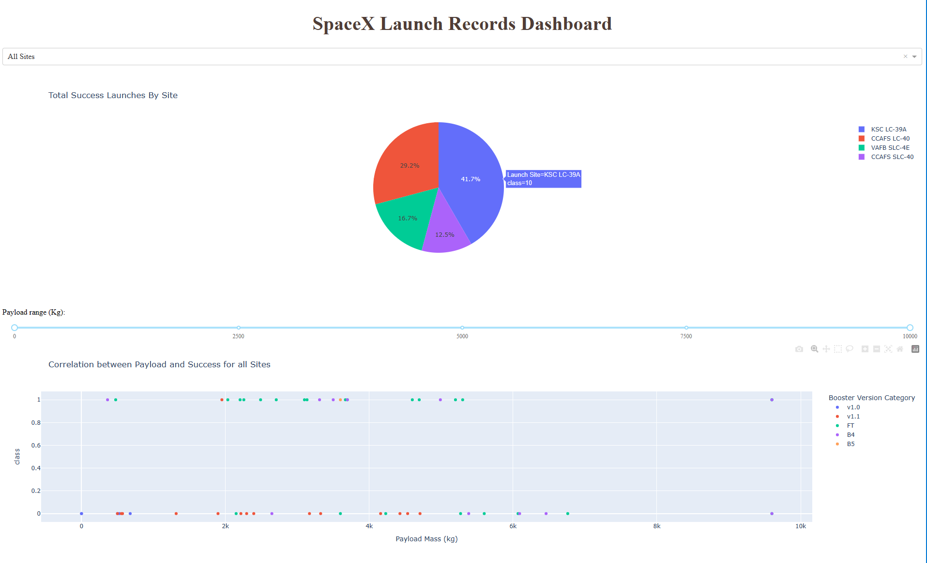
Results
The results of the EDA revealed that the success rate of the Falcon 99 landing was 66%
The Predictive Analysis results showed that the decision Tree algorithm was the best classification method with an accuracy of 94%

Slide 17

Section 2

Slide 18
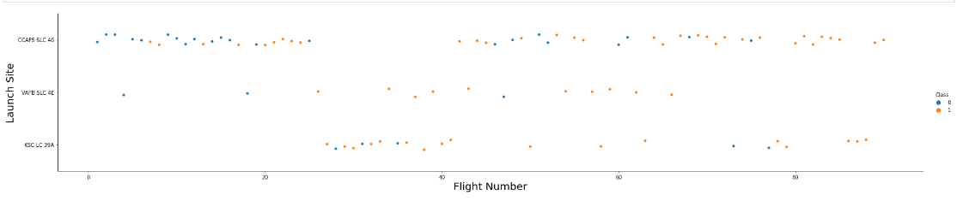
Flight Number vs. Launch Site
The red dots on the figure above represent the successful launches while the blue ones represent unsuccessful launches.
This figure shows that the success rate increased as the number of flights increased especially after th 40th launch.

Slide 19
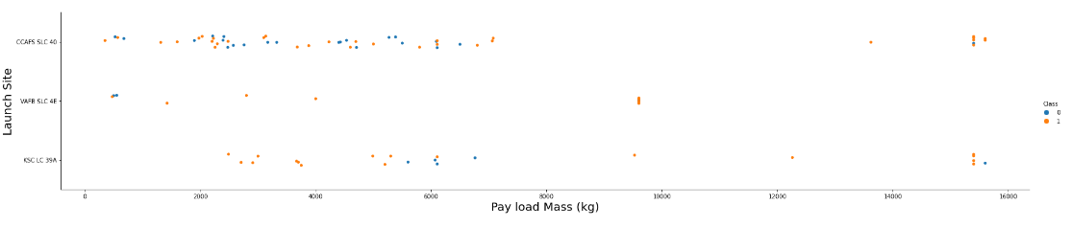
Payload vs. Launch Site
The red dots on the figure above represent the successful launches while the red ones represent unsuccessful launches.
This figure shows that there are no rocket launches with heavy payload mass for the VAFB-SLC. The correlation between Payload and Launch Site is weak therefore decisions can not be made using this metric.

Slide 20
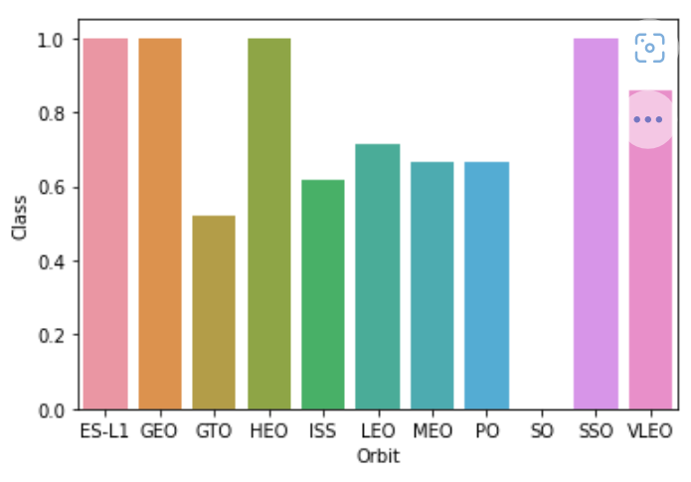
Success Rate vs. Orbit Type
SO orbit doesn’t have any successful launches.
SSO, HEO, GEO, ES-L1 have 100% success rate.

Slide 21
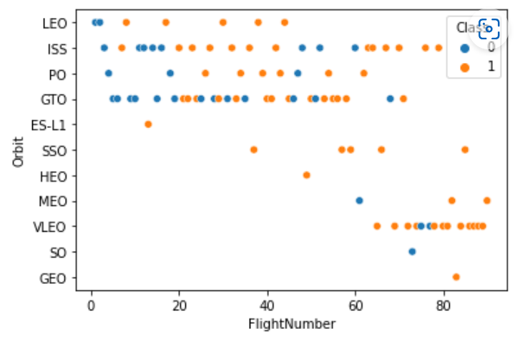
Flight Number vs. Orbit Type
Flights number greater than 40 have a higher success rate than flights numbers between 0 and 40.
SSO, HEO, ES-L1, GEO orbits have a 100% success rate
There is a positive correlation between LEO orbit and the number of flights.
There seems to be no correlation between GTO orbit and the number of flights.

Slide 22
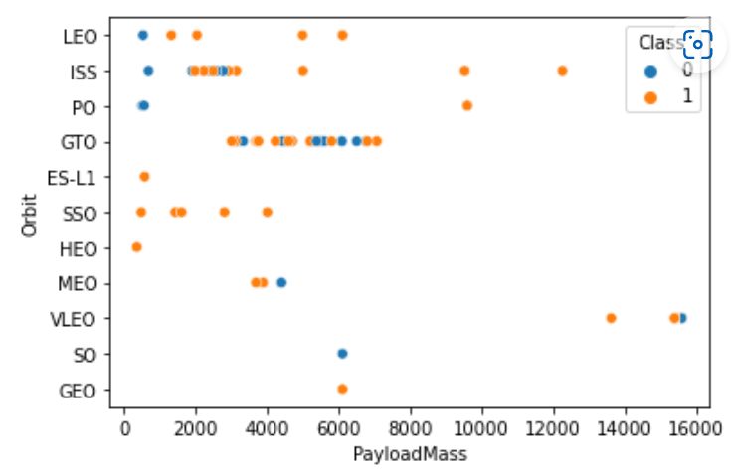
Payload vs. Orbit Type
For PO, SSO, LEO and ISS orbits the heavier the payload mass, the bigger the success rate.
There seems to be no correlation between GTO orbit and the payload mass.

Slide 23
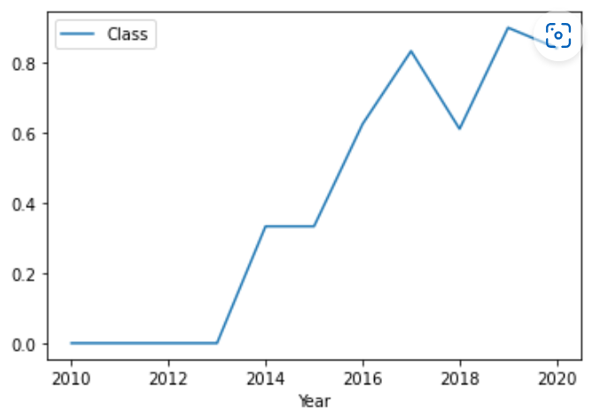
Launch Success Yearly Trend
There is a strong trend to increase in landing success rate through years.

Slide 24
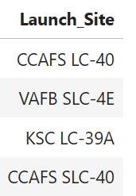
All Launch Site Names
The DISTINCT clause was used to return unique values from the Launch_Site column. There are 4 unique launch sites. They are:
CCAFS LC-40
VAFB SLC-4E
KSC LC-39A
CCAFS SLC-40

Slide 25
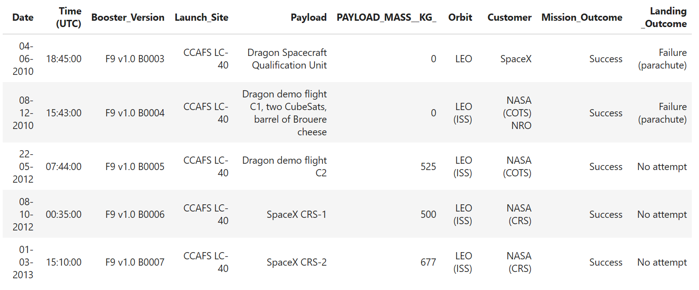
Launch Site Names Begin with 'CCA'
The LIMIT and LIKE clauses were used to display first five rows where Launch_Site name started with ‘CCA’.

Slide 26
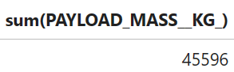
Total Payload Mass
The SUM() function was used to calculate the total payload mass carried by boosters launched by NASA (CRS).

Slide 27
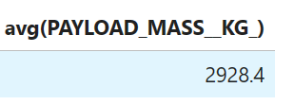
Average Payload Mass by F9 v1.1
The AVG() function was used to calculate average payload mass carried by booster version F9 v1.1

Slide 28
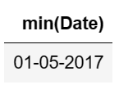
First Successful Ground Landing Date
The MIN() functions and WHERE clause were used to calculate the date when the first succesful landing outcome in ground pad was acheived

Slide 29
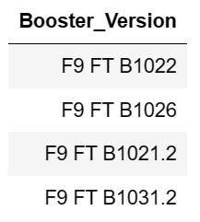
Successful Drone Ship Landing with Payload between 4000 and 6000
The BETWEEN and WHERE claused were used to display the names of the boosters which have success in drone ship and have payload mass greater than 4000 but less than 6000

Slide 30
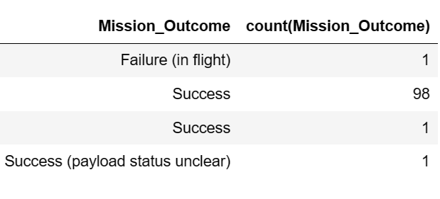
Total Number of Successful and Failure Mission Outcomes
The COUNT() function and WHERE clause were used to calculate the total number of successful and failure mission outcomes

Slide 31
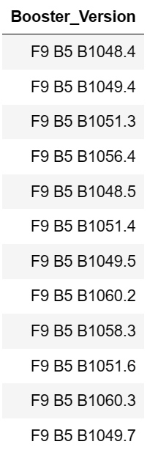
Boosters Carried Maximum Payload
The MAX() function in a subquery was used to dicplay the names of the booster_versions which have carried the maximum payload mass.

Slide 32
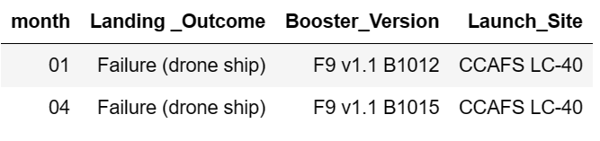
2015 Launch Records
The SELECT statement, WHERE and GROUPBY clauses were used to display the records which will display the month names, failure landing_outcomes in drone ship ,booster versions, launch_site for the months in year 2015.

Slide 33
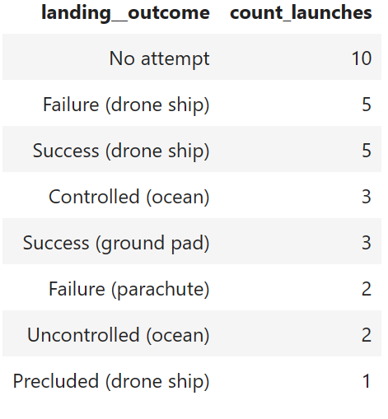
Rank Landing Outcomes Between 2010-06-04 and 2017-03-20
The COUNT() function, the WHERE, BETWEEN, GROUPBY and ORDERBY with DESC clauses were used to rank the count of successful landing_outcomes between the date 04-06-2010 and 20-03-2017 in descending order.

Slide 34

Section 3

Slide 35
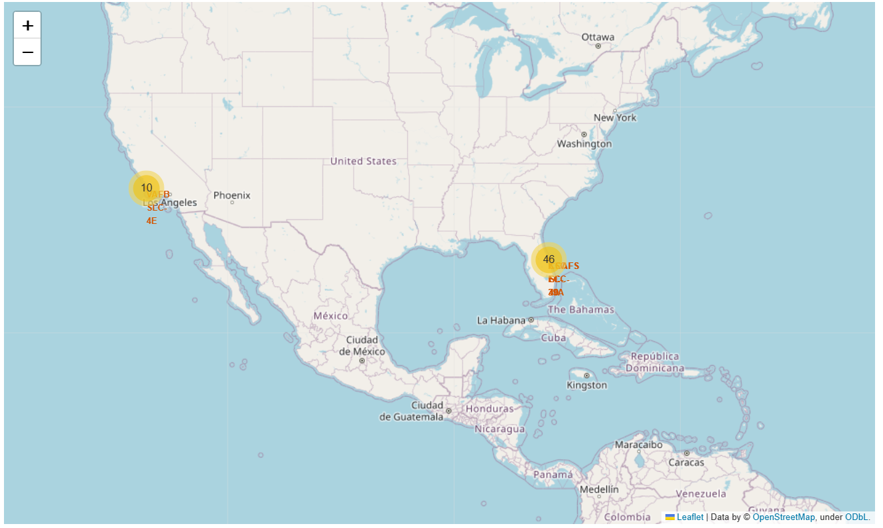
SpaceX Launch Sites Locations
The yellow markers indicate the locations of all the SpaceX launch sites. All sites are located in the southern part of the US near the coast.

Slide 36
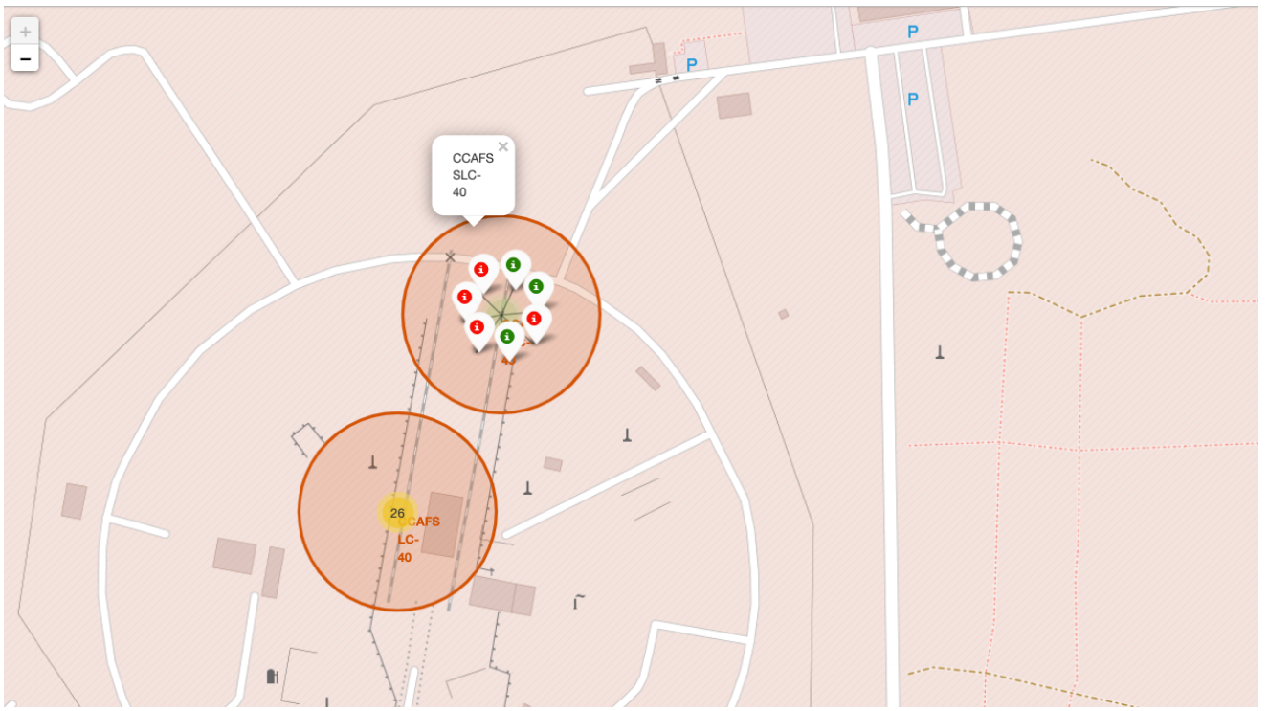
Success/Failure
All of the launch outcomes group in clusters where red markers represent failed launches and green markers represent successful launches.

Slide 37
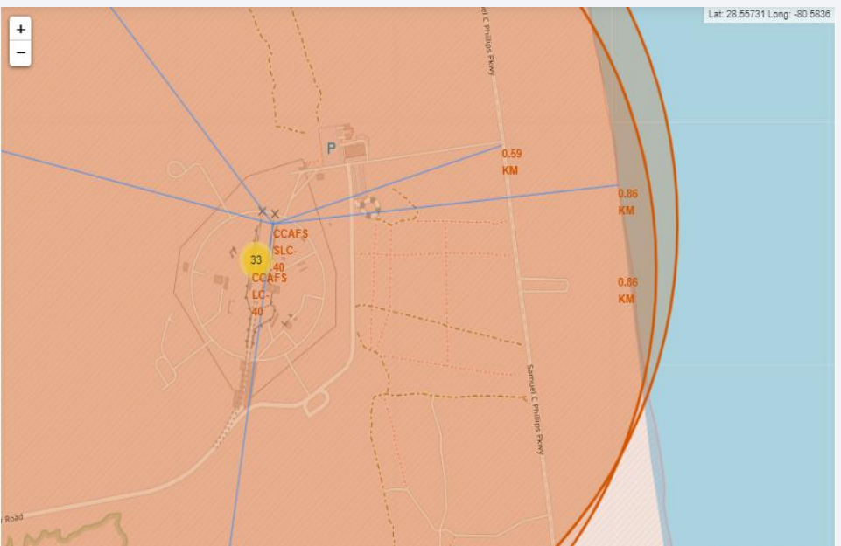
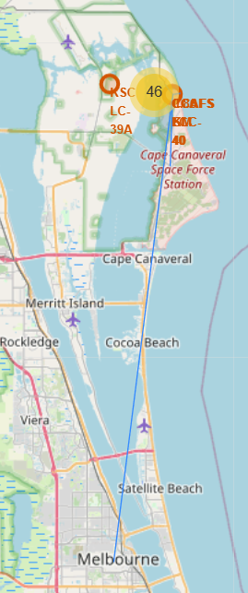
Launch Sites proximities
The map on the right displays distances to the nearest coast, city, highway and railroad. All of them pretty close to the launch site.

Slide 38

Section 4

Slide 39
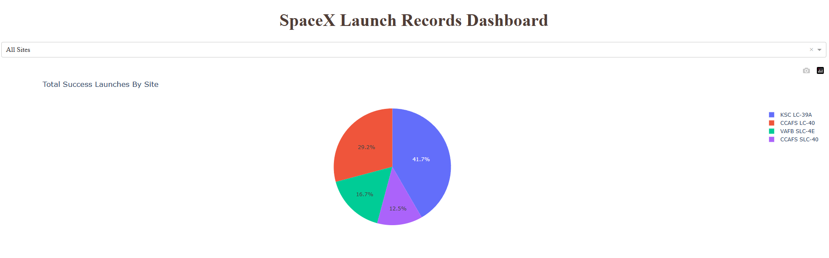
Total Successful Launches By Site
The KSC LC-39A Launch Site has the most successful launches with 41.7%

Slide 40
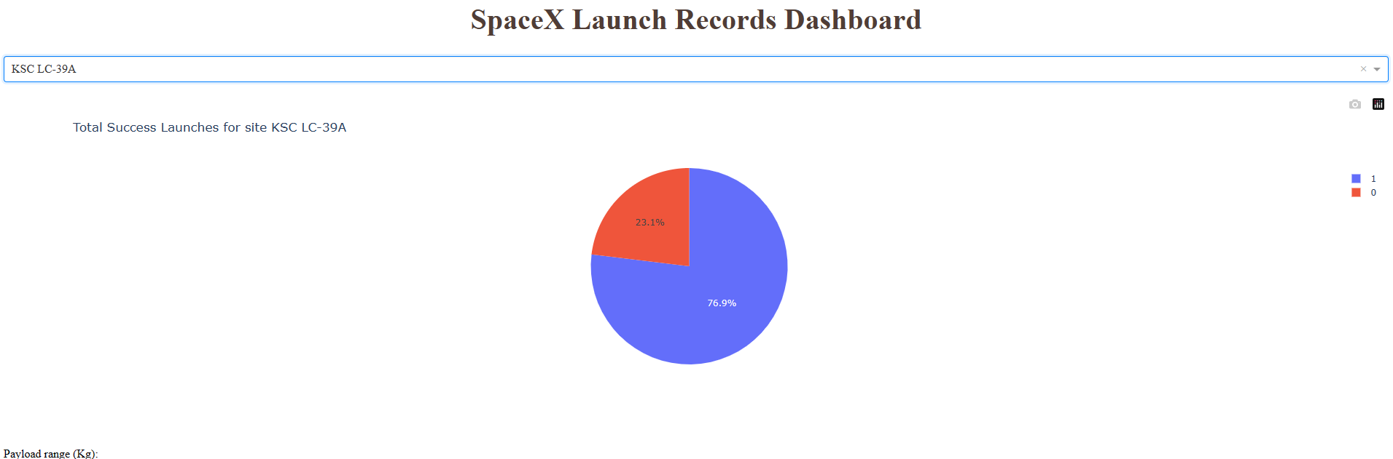
Launch Site With Highest Success Ratio
The KSLC-39A has the highest success rate with 76.9%

Slide 41
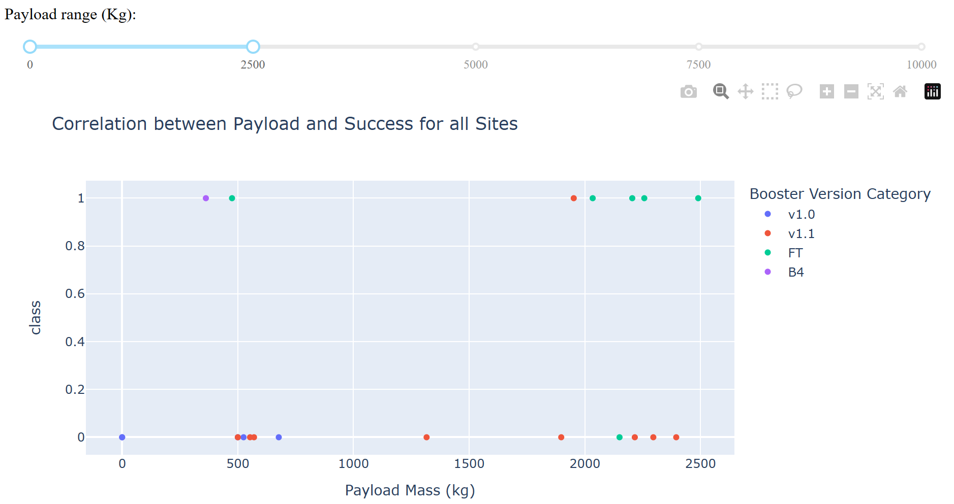
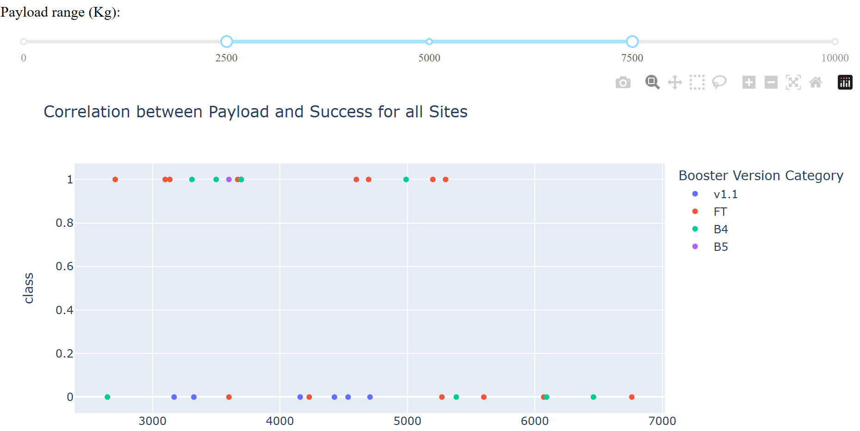
Payloads vs Launch Outcome
Replace <Dashboard screenshot 3> title with an appropriate title
Show screenshots of Payload vs. Launch Outcome scatter plot for all sites, with different payload selected in the range slider
The Booster v1.1 has the largest success rate as for payload mass under 2500 kg, as for payload mass in a range from 2500 to 7000 kg.
Overall the launch success rate for payloads under 2500 kg lower than for 2500 – 7000 kg.

Slide 42

Section 5

Slide 43
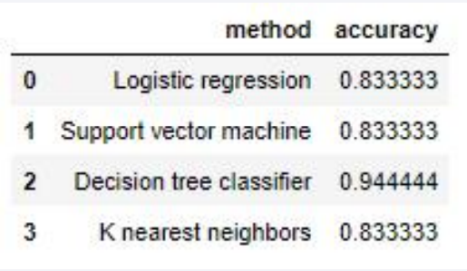
Classification Accuracy
The Decision Tree classifier has the best accuracy at 94%.

Slide 44

Confusion Matrix
The Decision Tree model predicts 15 landings correctly and 3 landings incorrectly (false positive).

Slide 45
Conclusions
The best predictive model to use for this dataset is the Decision Tree Classifier as it had the highest accuracy with 94%.
There are certain orbits like SSO, HEO, GEO, and ES-L1 where launches were the most successful.
The analysis showed that there is a positive correlation between number of flights and success rate as the success rate has improved over the years.

Slide 46
Appendix
GitHub Repository: https://github.com/DmLychev/Applied-Data-Science-Capstone

Slide 47


